Slide 1


BRAND IDENTITY DESIGN
BRANDCRAFTERS
A Design Company
Prepared by
DHANUSH M
DWIJESH SREERAM S

Slide 2
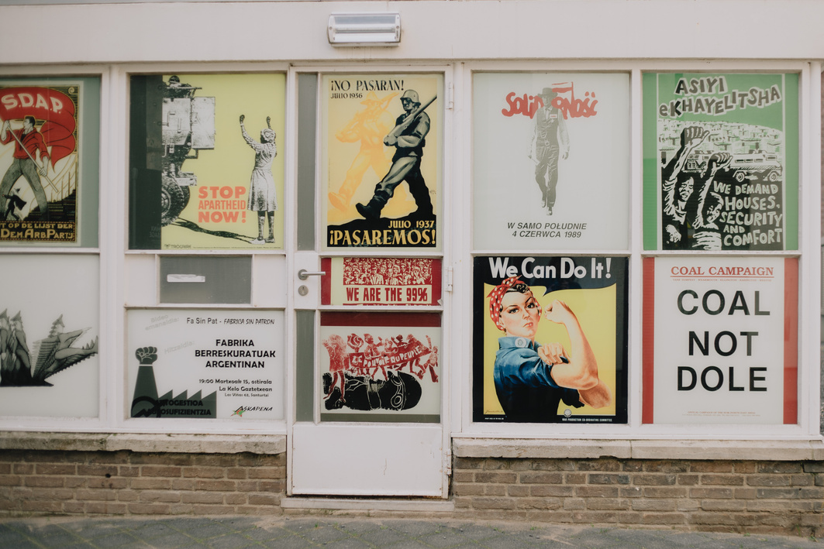
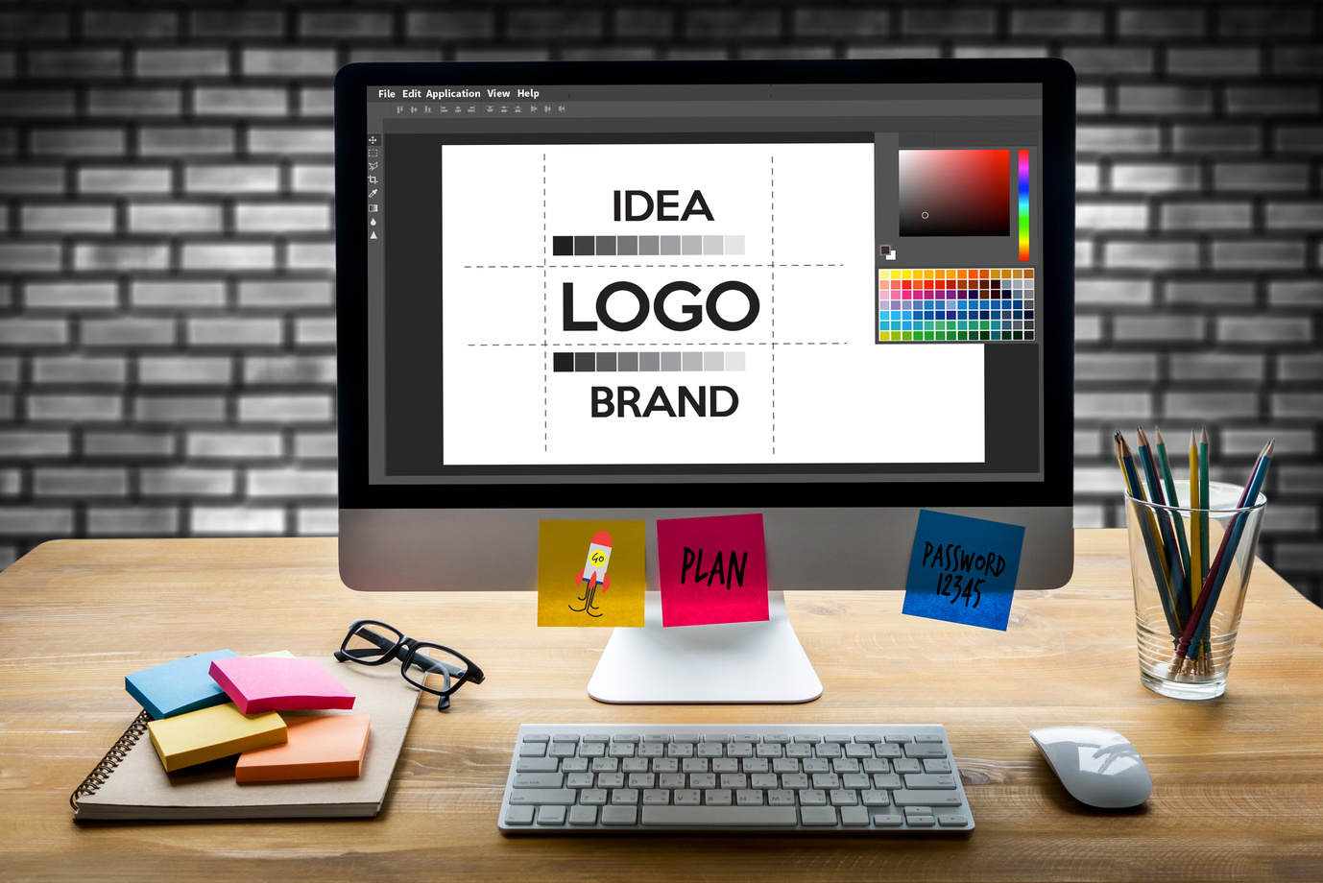
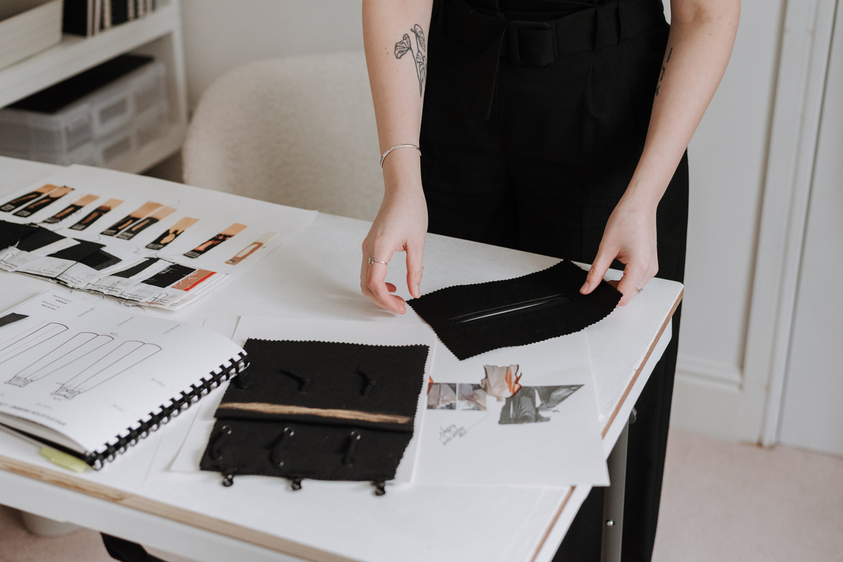
INTRODUCTION
Today, the effective design is crucial for establishing brand identity and connection with our customers . Our company recognises the importance of creating strong and visual engaging material that communicates our values, vision and offerings. This project is focus on creating the key design elements including logos, calendars and posters which will enhance our brand identity. By designing these materials , we aim to build a strong visual presence to our customers and set us apart in the market.

Slide 3

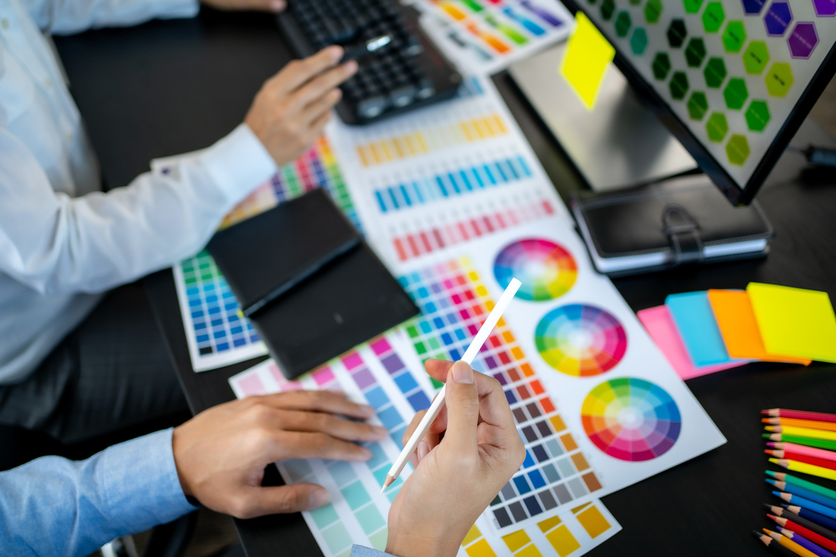

ABSTRACTY
In our project, we intend to do product design like logo design, posters, Products with our brand identity, banners for our Company . The logo design process will give more memorization and relevance to our company's value. The calendar design provides both utility and a consistent brand experience throughout the year. The poster design will show our campaign product, event, impactful communication through creative visuals. overall it will create a brand identity to our Company.

Slide 4
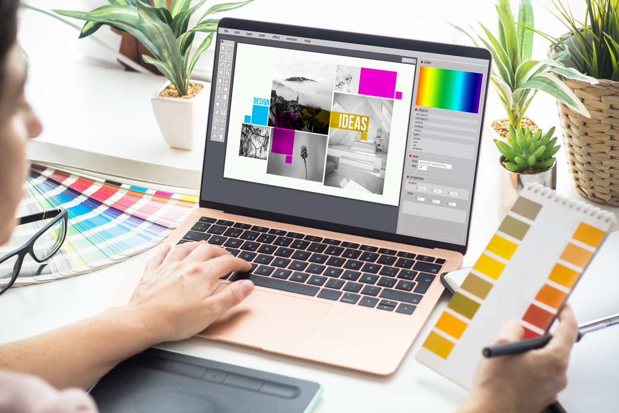

OBJECTIVE
To create visually cohesive designs that effectively communicate the company's identity, values, and offerings. The designs aim to engage the target audience, enhance brand recognition, and promote the company's services or products. By combining creativity with functionality, the logos, calendars, and posters will serve as powerful tools for marketing, customer engagement, and reinforcing the company’s presence in its industry.

Slide 5


LITERATURE SURVEY
Co-Optex
Pothys
Arvind
FONT
Times New Roman
Georgia and Brush Script
Roboto and Helvetica
Red, gold, and green
Gold, deep red, and maroon
Shades of Blue and white
COLOR
By Reviewing and taking surveys from other Industry designs, they will design logos and promoting their products for branding. But our product design that shows industry’s not only a promoting a brand and also shows a vision and mission of our industry. So, this will promote our products to the Audience easily.

Slide 6


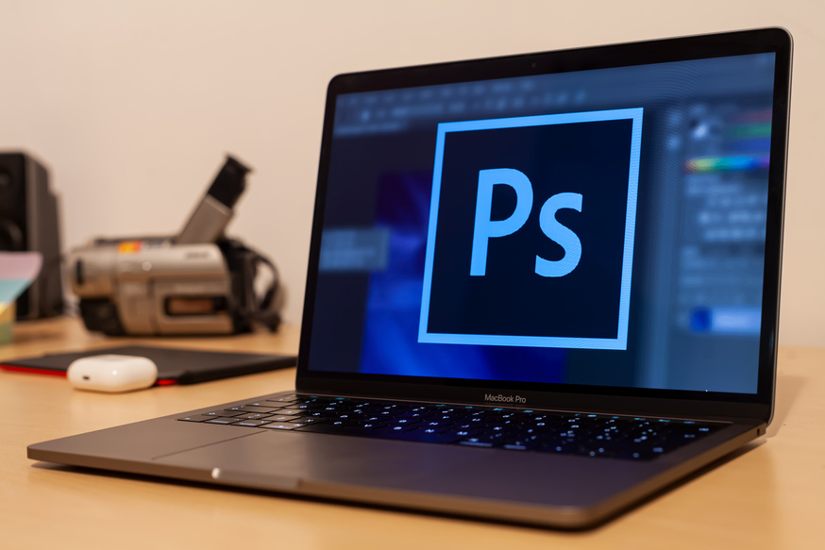
PROPOSED METHODOLOGY
In our project ,we use simple geometric shapes and we develop that can adapt to different themes, it also have unique typeface for your brand that resonates with its identity.
In calendar, we design with Feature different themes each month, such as sustainability, culture, innovation, or your company milestones.
The posters that are created for company events with striking visuals and cohesive branding and with the help of abstract designs that subtly integrate your company logo or core elements of your brand

Slide 7

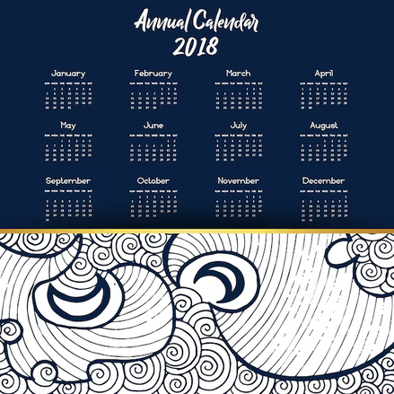
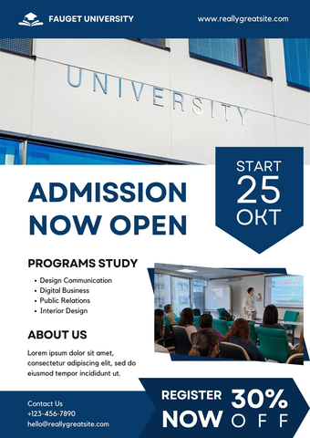

EXPECTED OUTPUT
LOGO DESIGN
CALENDER DESIGN
POSTER DESIGN
IDENTITY CARDS, PRODUCT DESIGNS and PROMO VIDEOS about overall project.

Slide 8


INSTITUTION LOGO DESIGN
The logo represents the university's vision and values, embodying excellence in education.
The color scheme symbolizes wisdom, integrity, and leadership in academic pursuits.
The typography is carefully chosen to convey professionalism and inclusivity.
The motto "Learn Today, Lead Tomorrow" is integrated to inspire students and faculty.
This logo serves as a powerful identity, fostering pride and unity within the university community.
An Education Institution Graphic Design Project

Slide 9

INSTITUTION LOGO DESIGN
The university logo is designed to be versatile, ensuring visibility on both light and dark backgrounds.
The color scheme is carefully chosen to maintain clarity and contrast in different lighting conditions.
A dark background enhances the brightness of lighter logo elements, making them stand out.
A light background ensures darker elements remain sharp and easily readable.
The design maintains brand consistency while adapting to various presentation needs.
Both versions of the logo retain the university’s identity, symbolizing professionalism and prestige.
An Education Institution Graphic Design Project

Slide 10
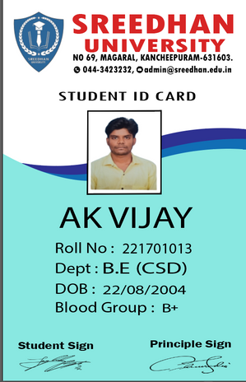
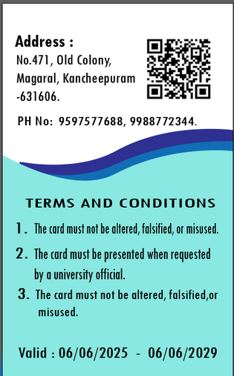
INSTITUTION ID CARD DESIGN
To design a Student ID Card for a university, focus on including the university's logo, the student's photo, and key details like name, ID number, course, and department.
Choose a professional and readable font, with colors that reflect the university's branding.
Ensure the layout is balanced, with clear sections for easy identification and security features.
An Education Institution Graphic Design Project

Slide 11
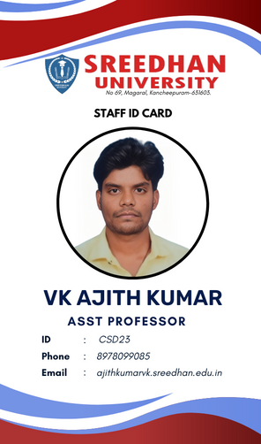
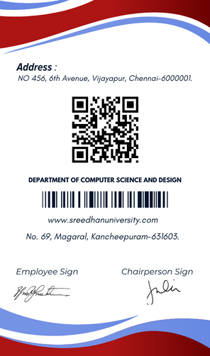
INSTITUTION ID CARD DESIGN
Use a clean, professional layout with the university logo at the top, staff photo on the left, and essential details.
Incorporate the university's official colors for consistency and branding, ensuring readability with contrasting text colors for clear identification.
Include a barcode/QR code for scanning, a staff ID number, and a holographic seal or watermark to prevent unauthorized duplication.
An Education Institution Graphic Design Project

Slide 12

INSTITUTION POSTER DESIGN
To design a university poster, focus on a clean, professional layout with clear headings and readable fonts.
Use the university's branding colors and logo to maintain consistency.
Include essential information such as event details or announcements, ensuring it's visually balanced and engaging.
An Education Institution Graphic Design Project

Slide 13

INSTITUTION PAMPHLET DESIGN
To design a university pamphlet, start by choosing a clean, professional layout with the university's branding colors and logo. Include a compelling headline that highlights the university's key features, such as academic excellence and campus life.
Organize content into clear sections, like programs offered, facilities, and student testimonials. Use high-quality images of the campus and students to create visual interest.
Finish with a call to action, such as contact information or enrollment details, ensuring the design is easy to navigate.
An Education Institution Graphic Design Project

Slide 14

INSTITUTION SAMPLE DEGREE CERTIFICATE DESIGN
Use a clean and formal design, incorporating the university's logo, seal, and name prominently at the top, with clear borders and a structured format for the content.
Choose elegant, readable fonts for headings and body text. Include the degree title, recipient’s name, degree details, date, and authorized signatures, with appropriate spacing.
An Education Institution Graphic Design Project

Slide 15
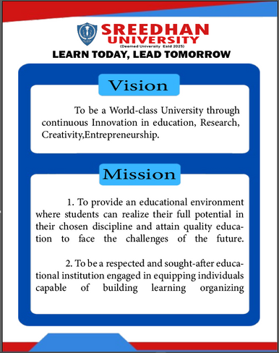
INSTITUTION AGENTA DESIGN
Keep a clean, structured design with a balanced mix of text and visuals. Use the university’s brand colors and fonts for consistency.
Represent key values with relevant icons or images. Use minimal yet impactful visuals.
An Education Institution Graphic Design Project

Slide 16
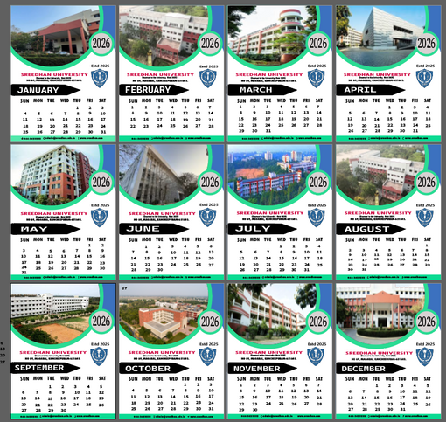
AN EDUCATION INSTITUTION GRAPHIC
DESIGN PROJECT
Reinforce the university’s image through logos, colors, and official themes. Provide students, faculty, and staff with key academic dates, deadlines, and events. Promote participation in university events, workshops, and extracurricular activities. Help students and faculty manage their schedules efficiently. Feature university milestones, quotes, or notable alumni to inspire the community.
CALENDAR DESIGN

Slide 17
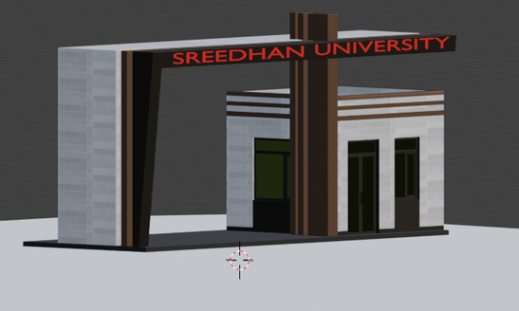
AN EDUCATION INSTITUTION GRAPHIC
DESIGN PROJECT
Design Concept – Realistic and grand university entrance with detailed architecture.
Tools Used – Modeled in Blender with texturing, lighting, and rendering.
Purpose – For presentations, virtual tours, and promotional materials.
3D COLLEGE ENTRANCE

Slide 18
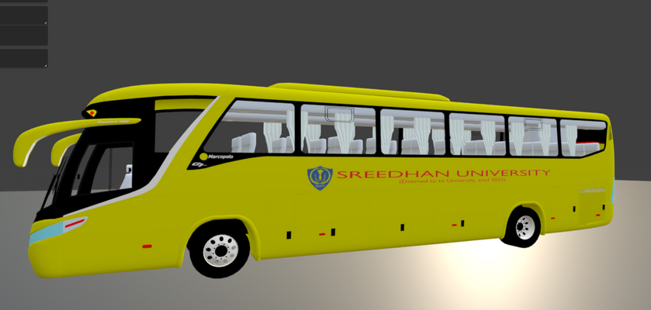
AN EDUCATION INSTITUTION GRAPHIC
DESIGN PROJECT
3D MODEL BUS DESIGN
Design & Branding – Realistic bus model with university logo, colors, and details.
Modeling & Visualization – Created in Blender with textures, lighting, and accurate proportions.
Usage & Application – Used for promotions, virtual tours, and transportation planning

Slide 19
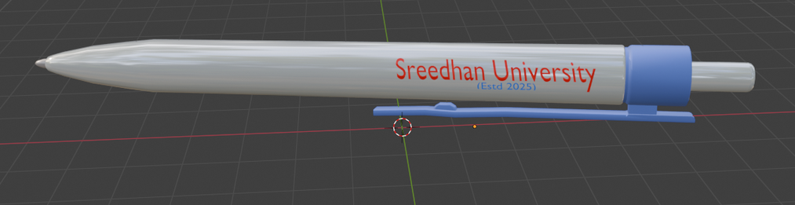
AN EDUCATION INSTITUTION GRAPHIC
DESIGN PROJECT
3D MODEL PEN DESIGN
A sleek, ergonomic pen modeled in 3D, incorporating university branding for a professional look.
Material & Texture – Designed with high-quality textures, simulating metal, plastic, or wood for a realistic appearance.
Presentation & Application – Showcased in product mockups and rendered for promotional and merchandising purposes.

Slide 20
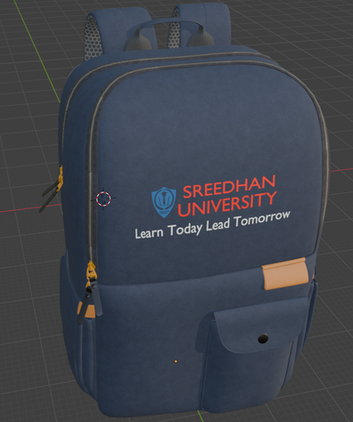
AN EDUCATION INSTITUTION GRAPHIC
DESIGN PROJECT
Developed a realistic 3D model of the bag in Blender, showcasing textures, materials, and structural details.
Focused on ergonomics, durability, and functionality, ensuring the bag is stylish, comfortable, and practical for students.
3D MODEL COLLEGE BAG DESIGN

Slide 21
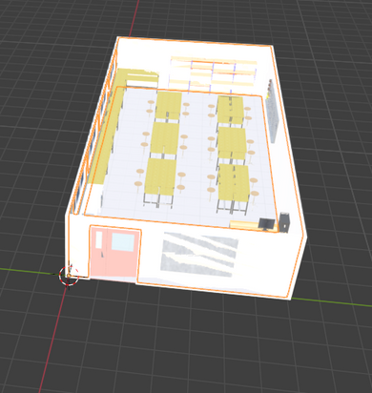
AN EDUCATION INSTITUTION GRAPHIC
DESIGN PROJECT
Showcase of a functional and aesthetically appealing university lab product designed for enhanced usability and efficiency.
Clear, realistic 3D models to demonstrate the design concept, material choices, and intricate details of the product.
Focus on how the product meets the specific needs of a university lab environment, improving workflow and productivity.
3D MODEL LAB DESIGN

Slide 22
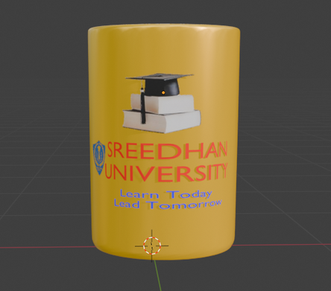
AN EDUCATION INSTITUTION GRAPHIC
DESIGN PROJECT
A 3D-modeled university-themed tea cup featuring the institution's logo, colors, and a sleek ergonomic design.
Ideal for students and faculty, promoting university branding while serving as a functional and stylish accessory.
3D MODEL CUP DESIGN

Slide 23
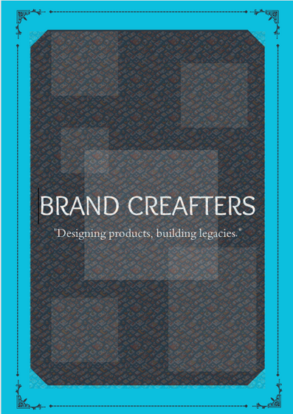
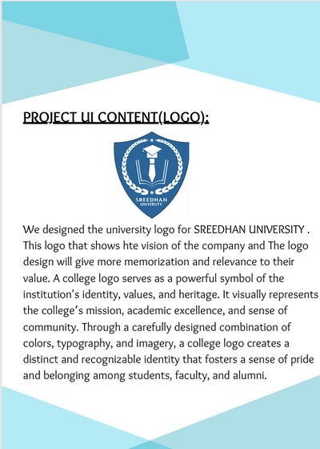
OUR GRAPHIC DESIGN BOOK BRANDCRAFTERS

Slide 24
OUR GRAPHIC DESIGN BOOK
BRANDCRAFTERS
Fundamentals of Graphic Design – Principles, color theory, typography, and composition.
Design Tools & Techniques – Software (Adobe Illustrator, Photoshop, Blender), layout design, and branding.
Practical Applications – Logo creation, posters, digital media, UX/UI design, and 3D modeling.
Overall, The Graphic Design and Product Design for University was done.

Slide 25



